Slide 1


Department of Computer Science and Engineering College of Engineering, Guindy
Anna University, Chennai-25
VIDEO BASED CROWD ESTIMATION USING YOLO
CS23604 – CREATIVE AND INNOVATIVE PROJECT
GUIDE :
Dr. M. S. Karthika Devi,
DCSE, College of Engineering, Guindy
TEAM MEMBERS:
KIRUPA V -2023103039
OJASKRISSHNAN S -2023103626
SINDHULAKSHMI E -2023103587
SHIYAMALADEVI J -2023103066

Slide 2

Introduction
Video surveillance systems continuously capture large volumes of visual data but rely heavily on manual human monitoring.
Such systems lack automated mechanisms to provide quantitative crowd information such as people count and density levels.
Advancements in computer vision and deep learning enable automated detection and analysis of individuals in complex scenes.
Object detection models such as YOLO (You Only Look Once) offer real-time performance suitable for surveillance applications.
This project presents a video-based crowd estimation system that detects, counts, and classifies crowd density using CCTV footage and image datasets.

Slide 3

Problem Statement
Manual CCTV surveillance cannot provide accurate real-time numerical crowd estimation. Human operators struggle to estimate crowd density during peak and congested conditions. Traditional image-based counting methods fail due to occlusion, scale variation, and overlapping individuals. Existing systems often require complex retraining or extensive annotations. Therefore, an automated video-based crowd estimation system is required for reliable detection, counting, and density classification.

Slide 4
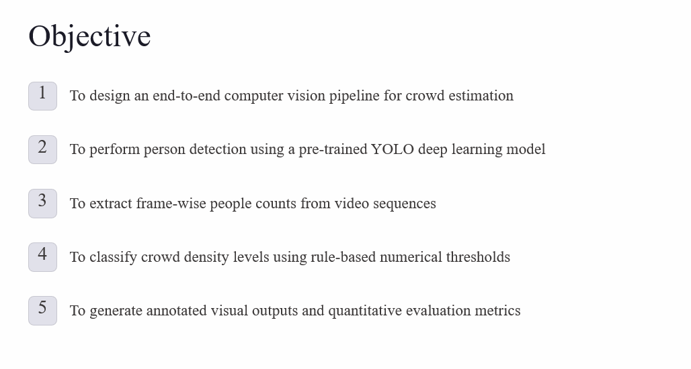

Slide 5
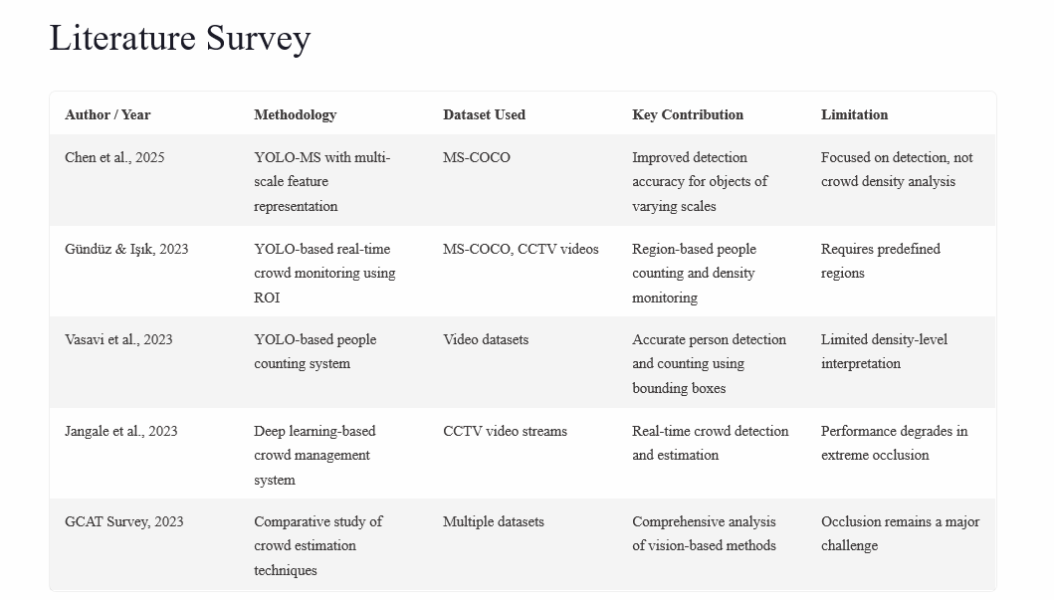

Slide 6

Proposed Work
• Develop a video-based crowd estimation framework using deep learning • Extract frames from CCTV video and preprocess them for analysis • Detect individuals using a pre-trained YOLO person detection model • Perform frame-wise people counting based on detected bounding boxes • Classify crowd density into predefined levels using rule-based thresholds • Generate annotated video output with people count and density labels • Evaluate system performance using accuracy, robustness, and efficiency metrics

Slide 7
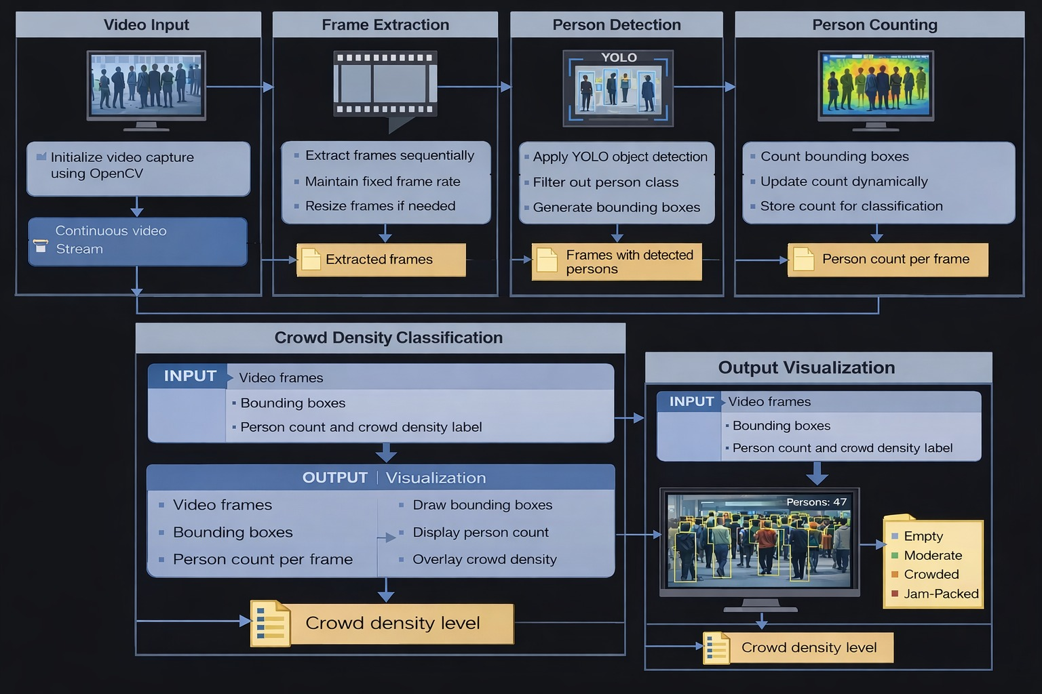
Architecture diagram:

Slide 8
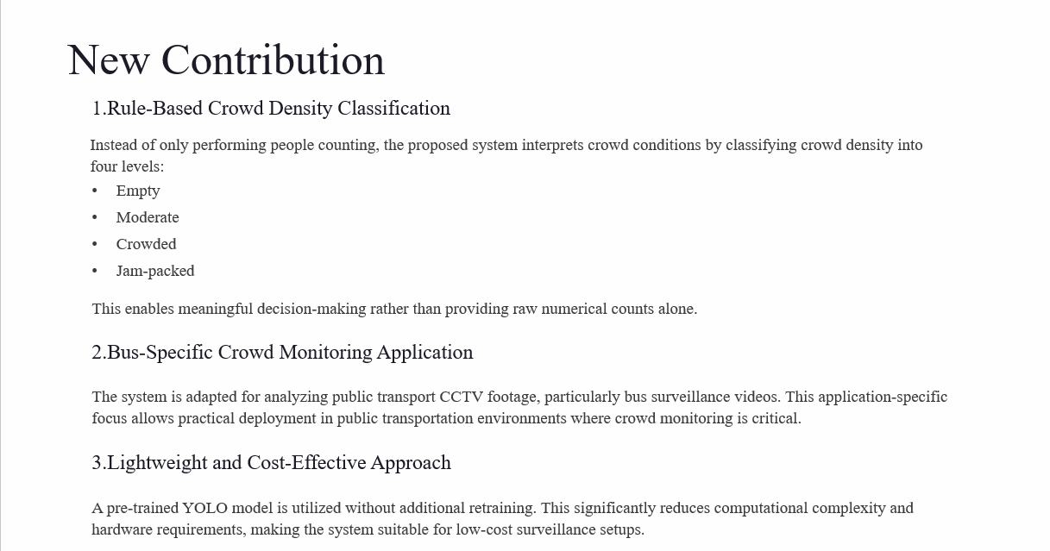

Slide 9

4.Video Annotation for Decision Support
The output video is annotated with:
Bounding boxes around detected persons
Total people count per frame
Crowd density classification label
These annotations enhance visual interpretability and support real-time monitoring.
5.Proof-of-Concept Oriented System Design
The system primarily operates on recorded video inputs, enabling easier testing, debugging, and validation. This design approach ensures the feasibility and correctness of the proposed methodology before real-time deployment.

Slide 10
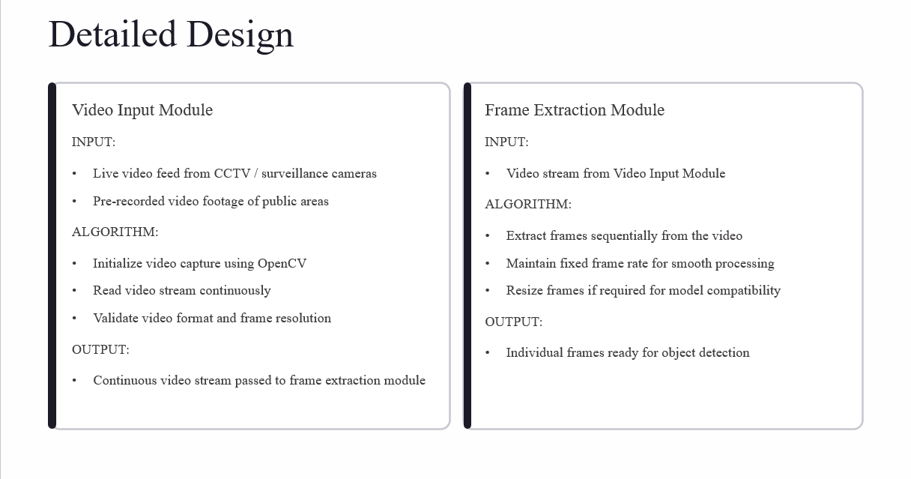

Slide 11
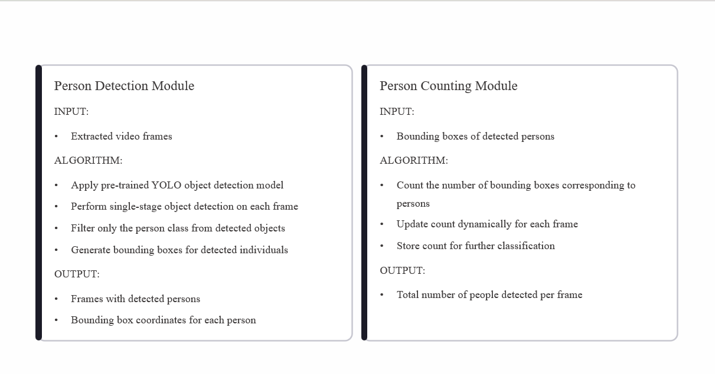

Slide 12
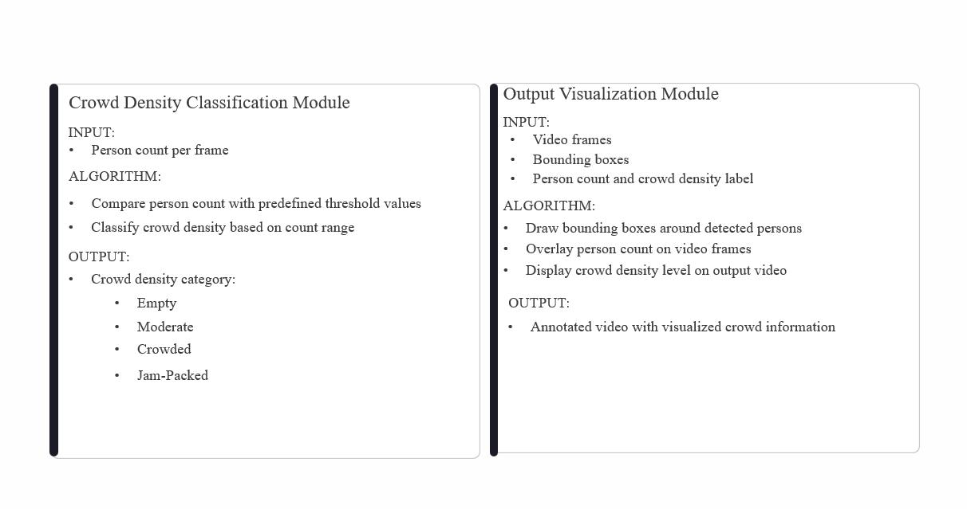

Slide 13
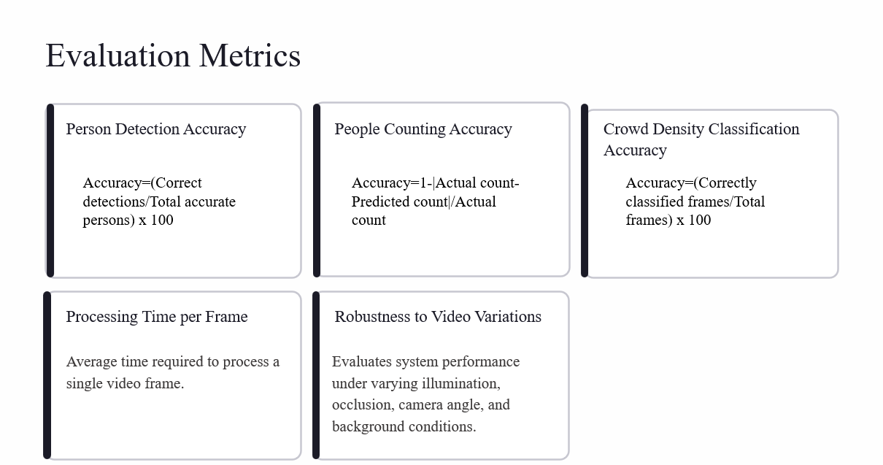

Slide 14
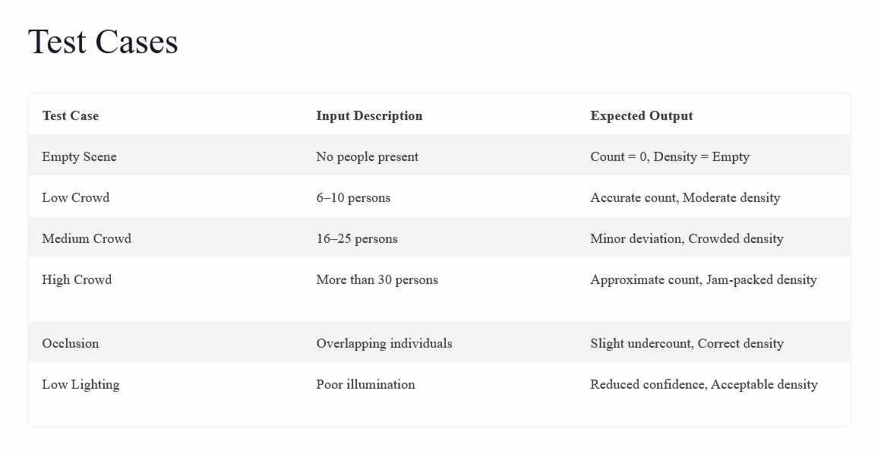

Slide 15
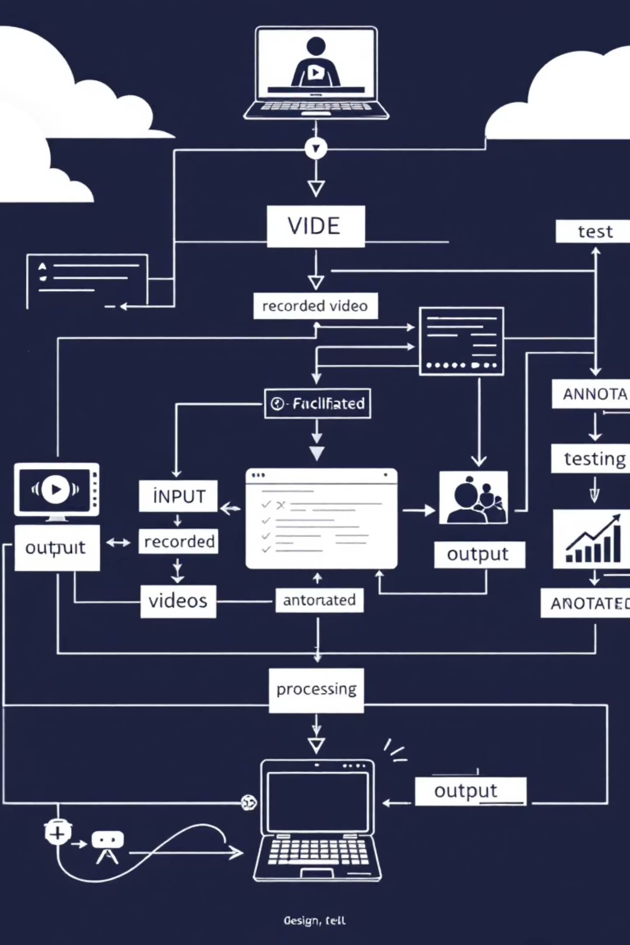
Conclusion
This project successfully demonstrates a video-based crowd estimation system using a YOLO-based person detection model. The system accurately detects individuals, performs frame-wise people counting, and classifies crowd density levels using rule-based thresholds. Experimental results indicate reliable performance under varying crowd and video conditions with efficient processing. The proposed approach is simple, scalable, and suitable for surveillance applications. In future, the system can be extended to real-time CCTV deployment and enhanced with advanced crowd analytics.

